Slide 1

Introduction to Robotics ME 639: Industrial Project Presentation 2
Project Title: AUV Coverage path planning
Team Name: Endsem Nahi Dena
Team Members: Harsh Mandalia, Vignesh, Kshitija Anam
Instructor: Prof. Harish PM
Teaching Assistant: Suraj Borate

Slide 2
Problem Statement:
“ Path planning for an AUV bathymetric survey.”
Industry name: Planys Technologies
Objectives:
Generate an obstacle free path for AUV traversal in given plot shape.
Coverage of maximum area possible through the planning algorithm, at best possible resolution.
1

Slide 3
Rationale / Approach / Ideas:
Modified and utilized Atsushi Sakai’s algorithm[1] for 2D area coverage through a lawn-mower pattern(i.e. End to end zig-zag layout pattern)
For more complete coverage of area, working on automated cell decomposition algorithms(TCP[2],BCP[3]) with cell traversal logic which provides following improvements:
Exploring regions using a targeted low resolution application of coverage algorithm to specific cells
Path planning from a particular cell to another(cell traversal logic)
New interim sensed static obstacle avoidance, through generation of blocked cell positions
2

Slide 4
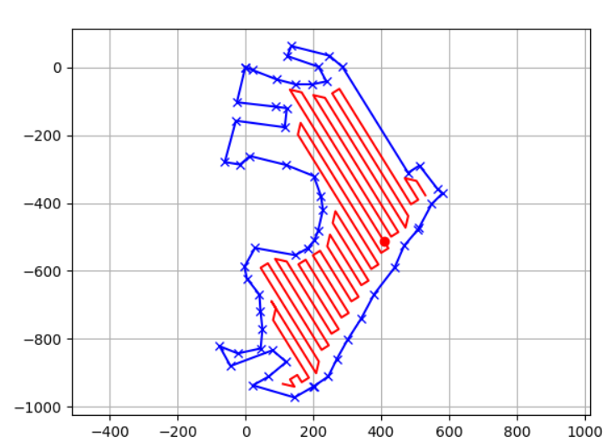

Key Results:Area 1 (Resolution=25m, Coverage area: 83.7%)
(
3

Slide 5
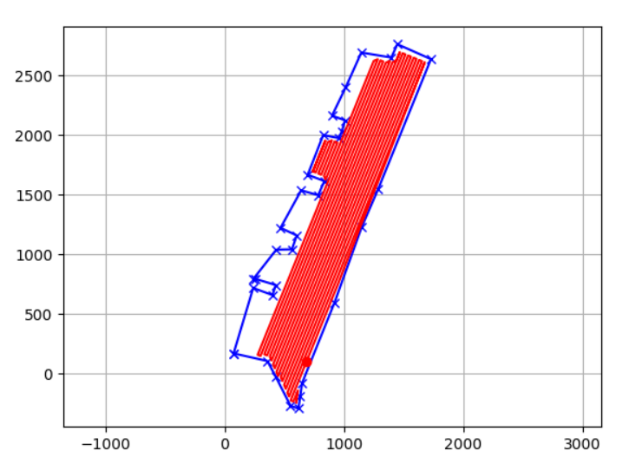
Key Results: Area 2 (resolution=25m, Coverage area: 81.7%)
3

Slide 6
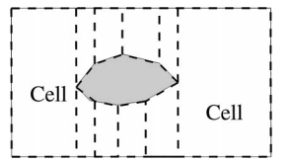
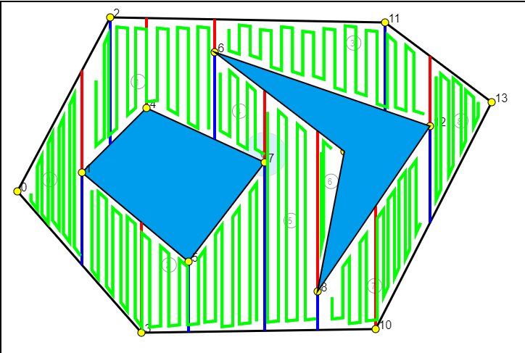
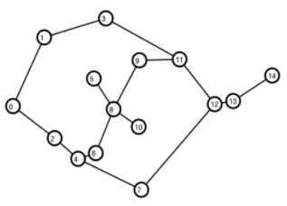
Proposed Ideas

Slide 7
Insights / Interim Conclusions / Discussion:
Incomplete coverage of crevice spaces at better resolution.
Cell Decomposition before applying lawn-mower coverage code.
Trapezoidal cell decomposition being explored. Customised cell slicing[4] might also be an option
Cell decomposition will involve “straightening” the border and slicing along interim “event points”(usually vertices of outer border/internal obstacle).
Further, a cell traversal order will be determined.
6

Slide 8
References:
Sakai, A. (n.d.). Python Robotics. Pythonrobotics. Retrieved November 2, 2021, from https://atsushisakai.github.io/PythonRobotics/.
Janchiv, A., Batsaikhan, D., Kim, B., Lee, W. G., & Lee, S. G. (2013). Time-efficient and complete coverage path planning based on flow networks for multi-robots. International Journal of Control, Automation and Systems, 11(2), 369-376.
Choset, H. Coverage of Known Spaces: The Boustrophedon Cellular Decomposition. Autonomous Robots 9, 247–253 (2000). https://doi.org/10.1023/A:1008958800904
G. Chen, Y. Shen, X. Duan, J. Wan, T. Yan and B. He, "Coverage Path Planning Based on Improved Exact Cellular Decomposition Method in Ocean Survey," Global Oceans 2020: Singapore – U.S. Gulf Coast, 2020, pp. 1-4, doi: 10.1109/IEEECONF38699.2020.9388979.

